Slide 1
Networking
400IT – W1-S1

Slide 2
Welcome!
Welcome to the Introduction to Networking Module! ☺
Who am I?
Mohamed Gorada
Tutor in Cyber Security
ae0904@coventry.ac.uk

Slide 3
Weekly Schedule
Every week you will have…
Pre- Activity
3 x Applied Content
Tutorial
Lab/Academic Skills Sessions
Post-Activity

Slide 4
Course Objectives
By the end of the module, students should be able to :
Understand the fundamental concepts of computer networking, including protocols, topologies, and network models.
Learn the OSI (Open Systems Interconnection) model and how it relates to network communication.
Gain knowledge of network hardware components, such as routers, switches, and network cables.
Understand the basics of IP addressing, subnetting, and routing in TCP/IP networks.
Gain hands-on experience in configuring and troubleshooting network devices and services.

Slide 5
Assignment 1 – Design and create a simple network & 1000-word report Assignment 2 – Online Multiple Choice test (90 minutes).
Assignments
23/05/20256pm
Last week w6

Slide 6
Learning Outcomes
Explain the function and operation of the main components of a Network.
Apply the concepts of communication within local and wide area networks, including access techniques.
Demonstrate an understanding of the protocols of wired and wireless technologies and their application in a professional computing context.
Design and implement a simple local area network (LAN).
Diagnose and correct simple network problems.

Slide 7
Assignment 1
Introduction :
This assignment focuses on designing and implementing a network infrastructure for Green Wood Company, which has its head office in London and branch offices in Manchester and York. The objective is to create an efficient network which is secure and scalable using the VLSM approach for IP addressing, applicable routing protocols, and VLAN configurations. Students are expected to conduct network testing and explain their findings demonstrating reliability and applicability of the designed network.

Slide 8
Assignment 1
Introduction :
You will be tasked with: Task 1: Design an IP Addressing Scheme using VLSM . Task 2: Building and configuring the network. Task 3: Implementing routing protocols. Task 4: Conducting basic network testing. Task 5: Provide a comprehensive report detailing your network design.

Slide 9
Assignment 1 – Design and create a simple network & 1000-word report Assignment 2 – Online Multiple-Choice test (90 minutes).
Assignments
23/05/20256pm
Last week w6

Slide 10
Learning Outcomes
Explain the function and operation of the main components of a Network.
Apply the concepts of communication within local and wide area networks, including access techniques.
Demonstrate an understanding of the protocols of wired and wireless technologies and their application in a professional computing context.
Design and implement a simple local area network (LAN).
Diagnose and correct simple network problems.

Slide 11
Assignment 2
Phase Test :
Online multiple-choice test of (90 minutes). This test covers topics from the whole module

Slide 12
Let’s get started!

Slide 13
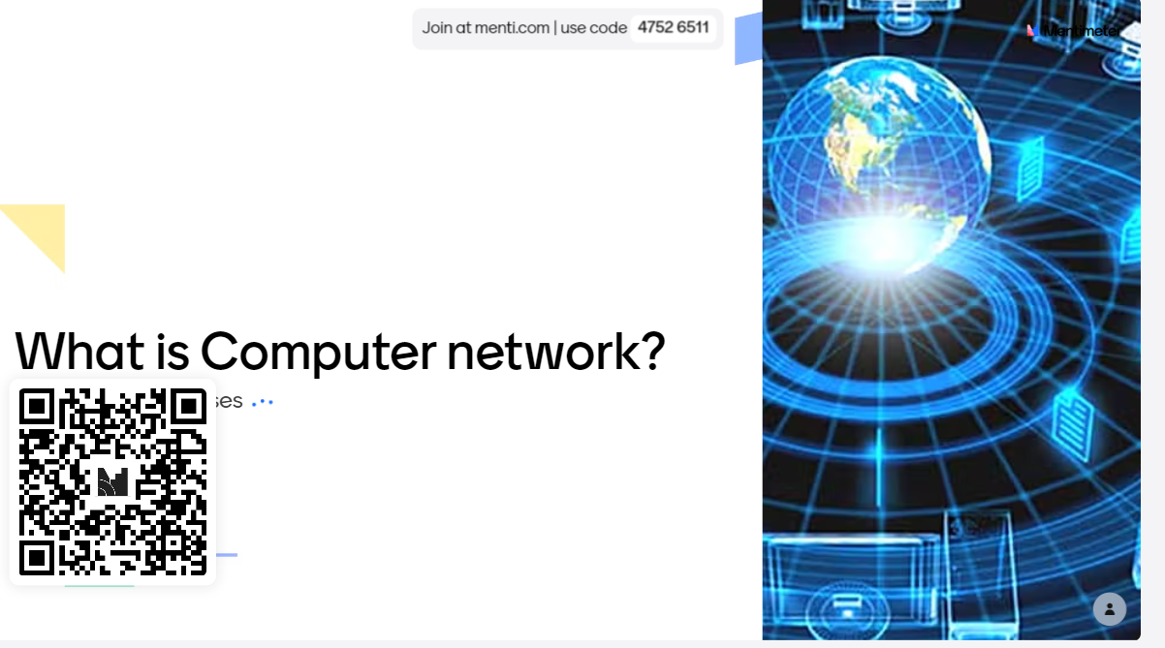
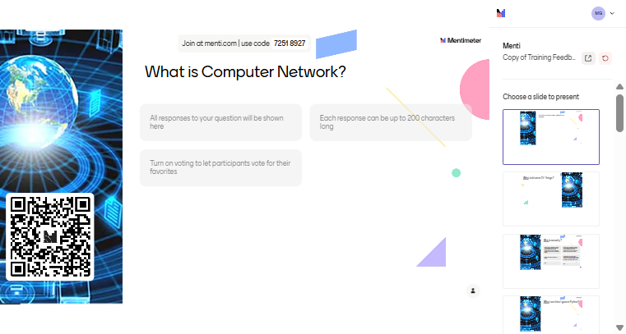
What is Computer network?

Slide 14
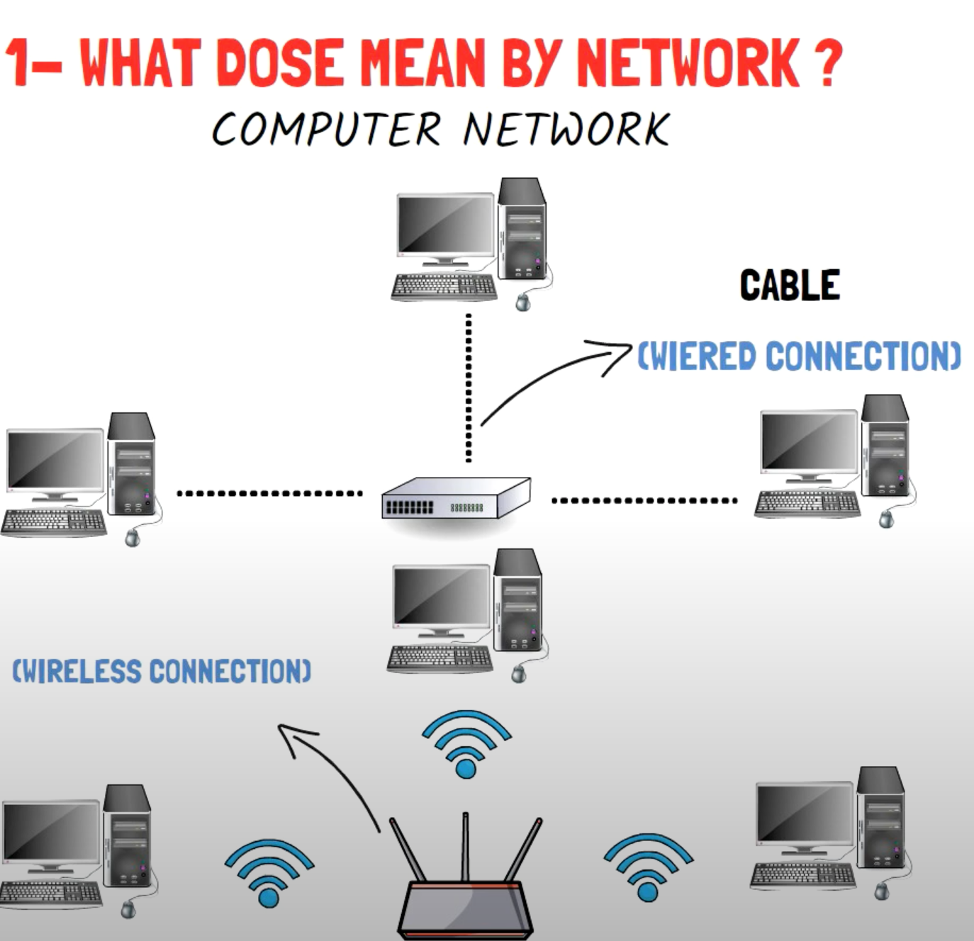
What is a Computer Network?

Slide 15
What is a Computer Network?
A computer network is…
A collection of computing devices connected in order to share resources, exchange information, and communicate with each other.
Connections between computing devices can be physical using wires or cables or wireless using radio waves or infrared signals.

Slide 16
What is a Purpose Of Network ?
Sharing resource reduce costs. Ex Sharing hardware (USB printer vs Network printers) .
Sharing data.
Data protection.
IPTV and online streaming services.
Access company services (ERP, Mail) .
Online games.
E-Learning.
Remote access to resources and data from anywhere.

Slide 17
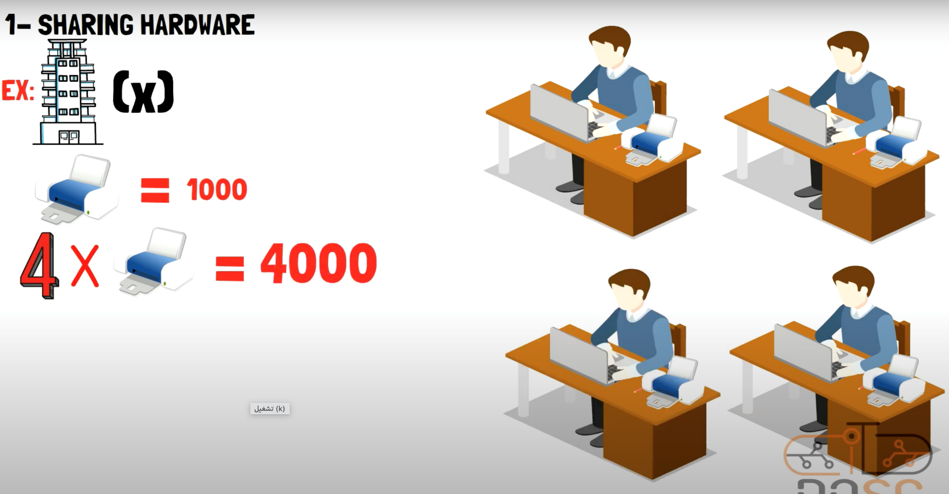
What is a Purpose Of Network ?

Slide 18
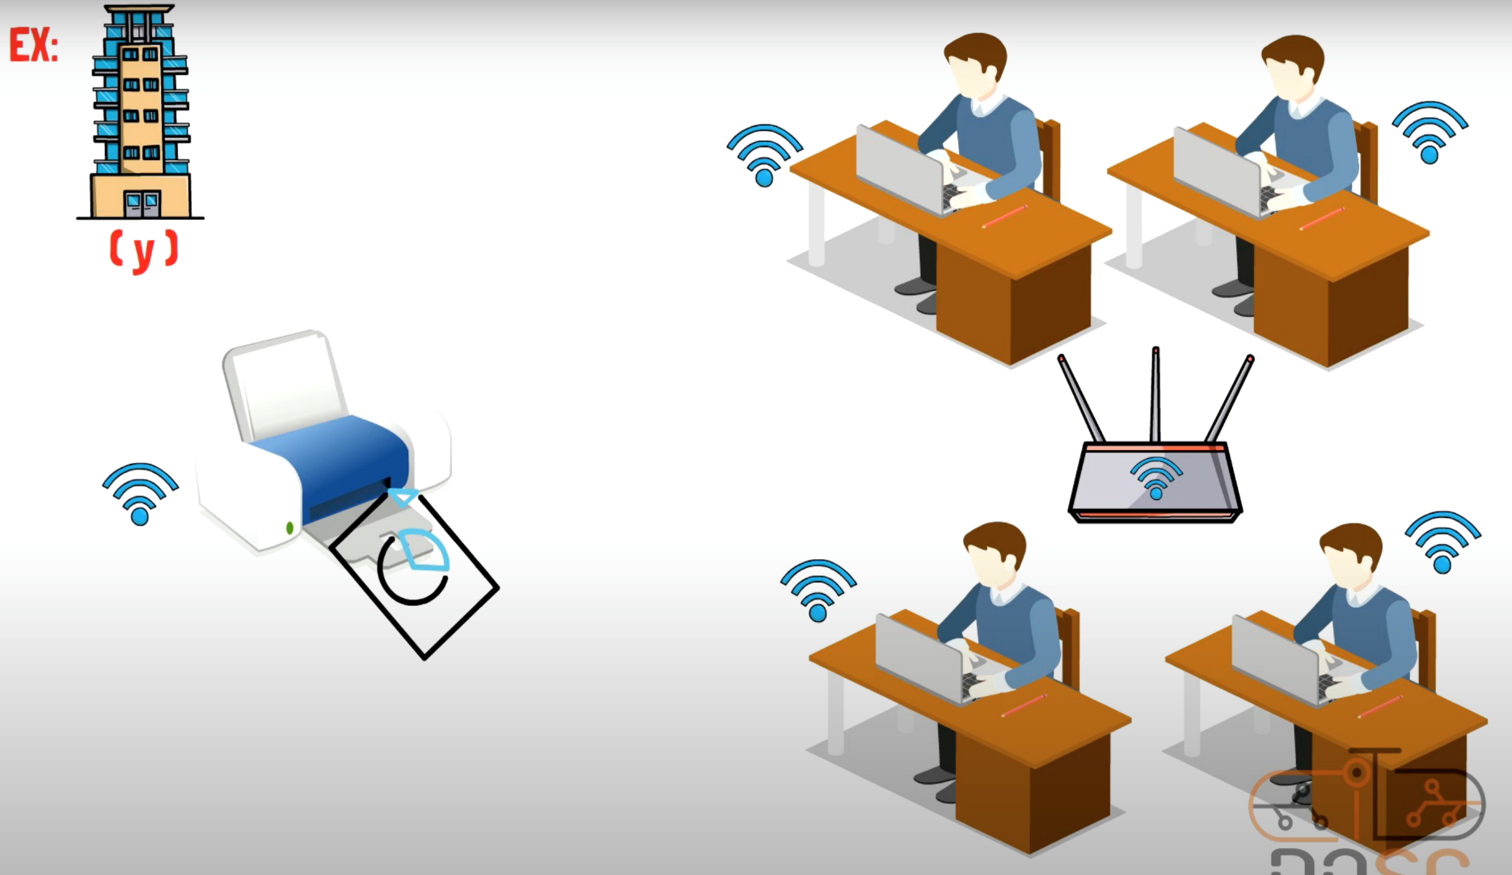
What is a Purpose Of Network ?

Slide 19
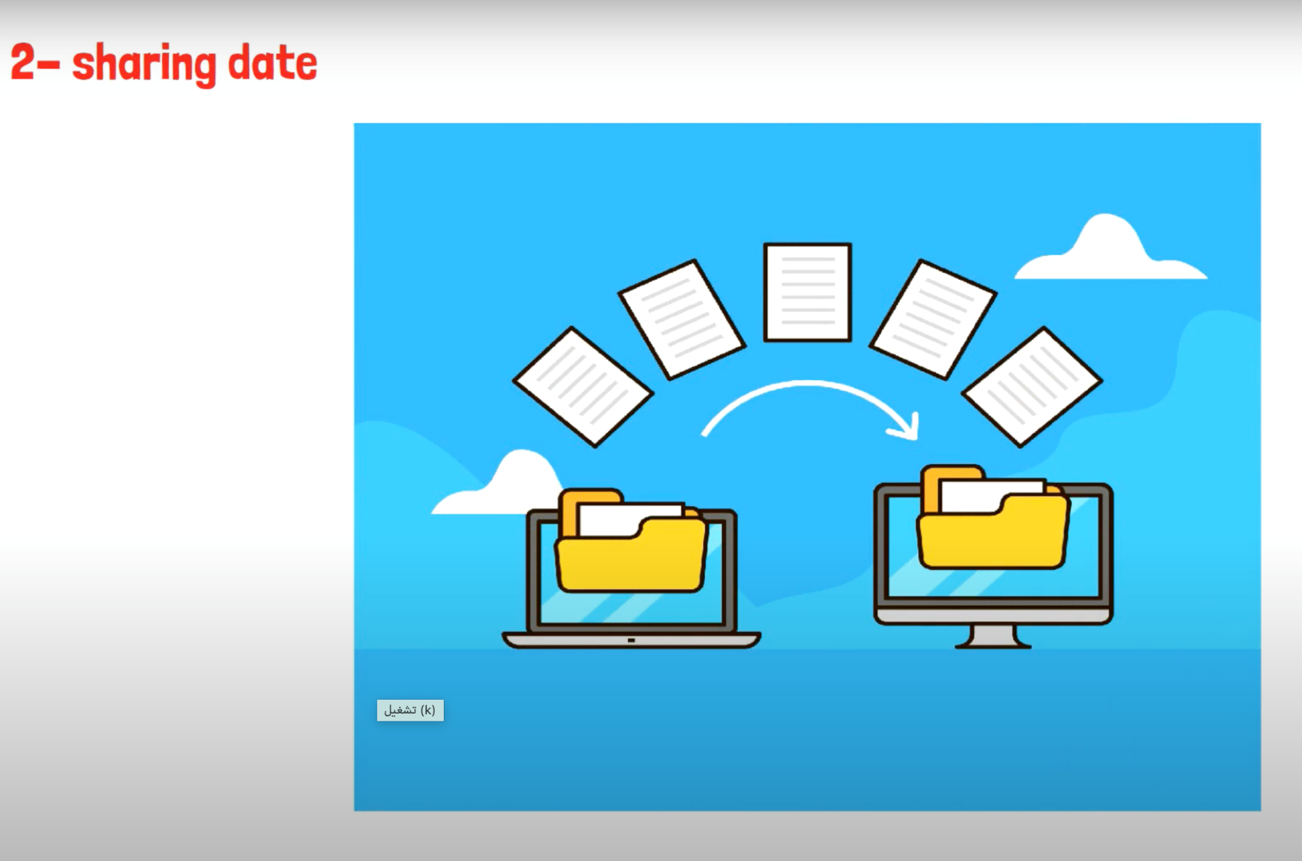
What is a Purpose Of Network ?

Slide 20
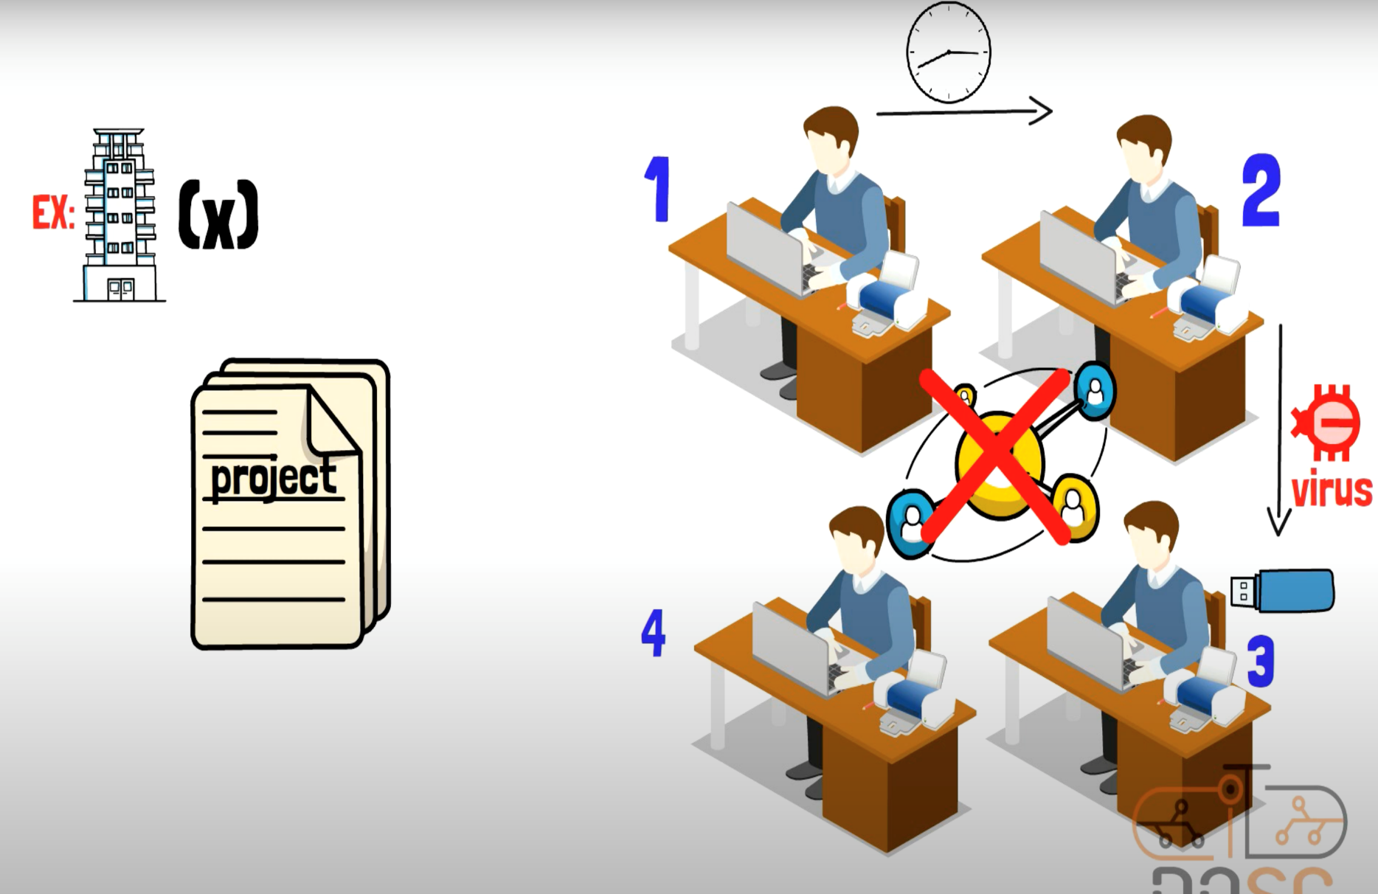
What is a Purpose Of Network ?

Slide 21
What is a Purpose Of Network ?

Slide 22
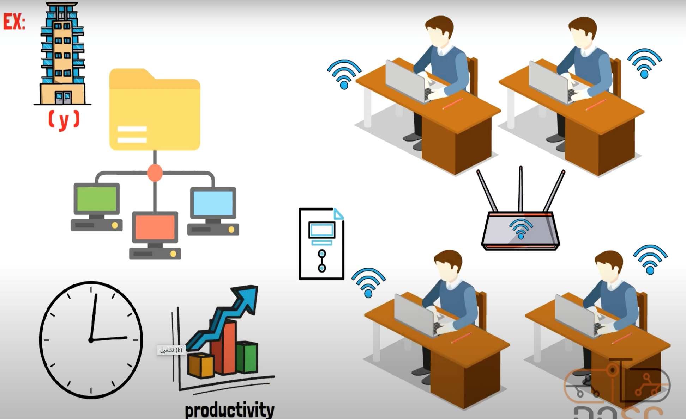
What is a Purpose Of Network ?

Slide 23
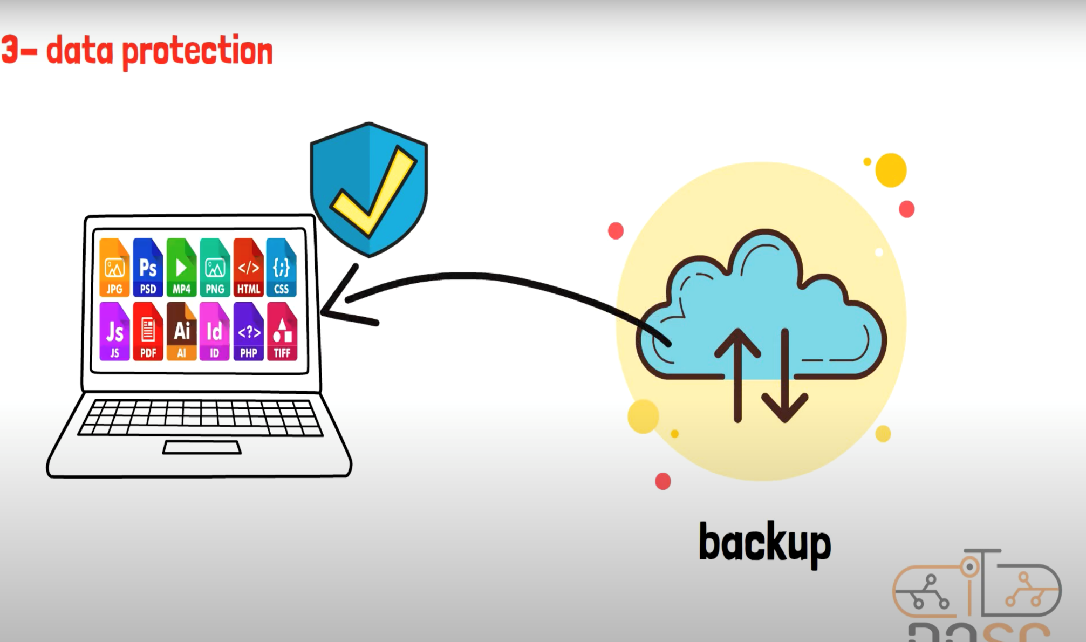
What is a Purpose Of Network ?

Slide 24
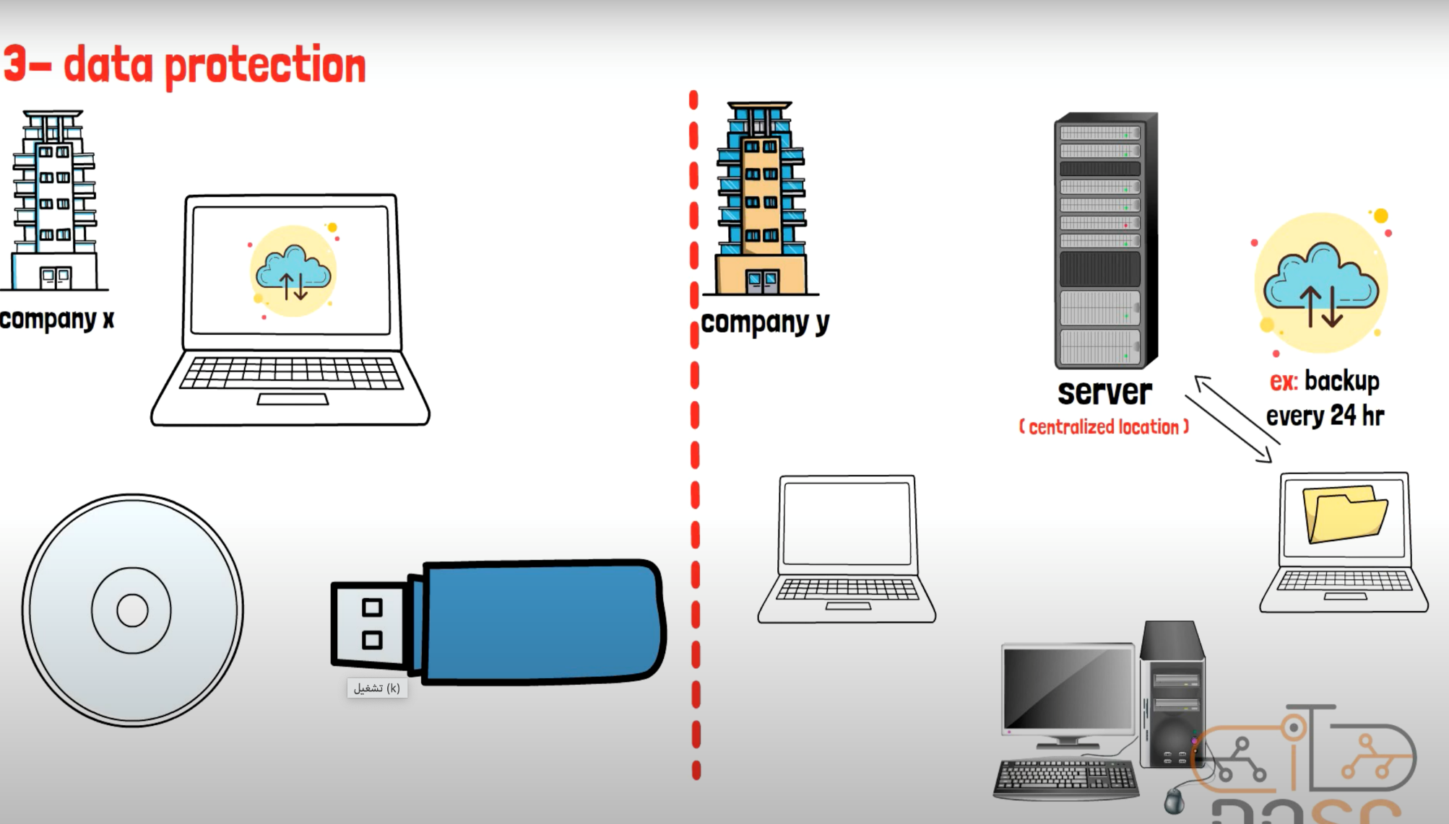
What is a Purpose Of Network ?

Slide 25
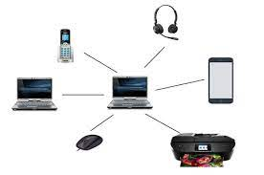
Types of Networks
Personal Area Network (PAN) is a small, short-range network used for connecting devices within a relatively small and personal space, typically within a range of a few meters to a few tens of meters.

Slide 26
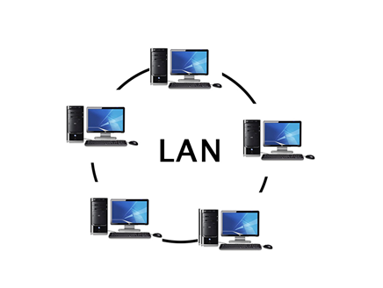
Types of Networks
Local Area Network (LAN): A LAN is a network that connects devices within a limited geographical area, such as a home, office, or building.
LANs typically use Ethernet or Wi-Fi technology and are commonly used for sharing resources, such as files, printers, and internet access, among devices within the same location.

Slide 27
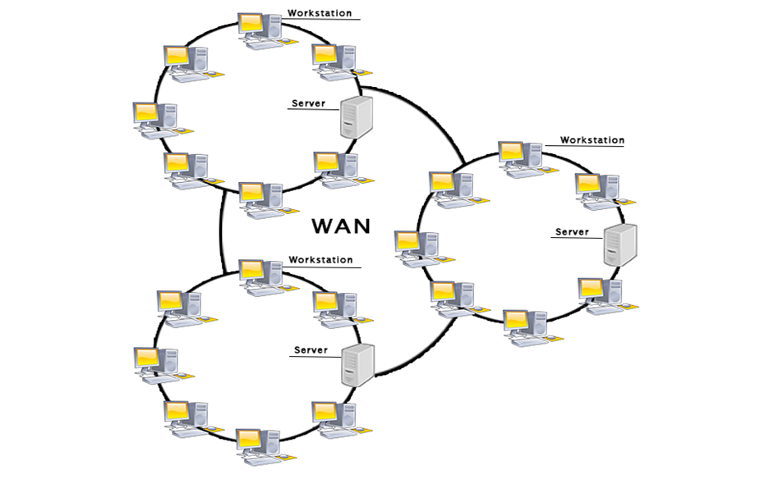
Types of Networks
Wide Area Network (WAN): A WAN covers a larger geographical area and connects multiple LANs or other networks together.
WANs can span cities, countries, or even continents. The internet is an example of a large-scale WAN that interconnects networks worldwide.

Slide 28
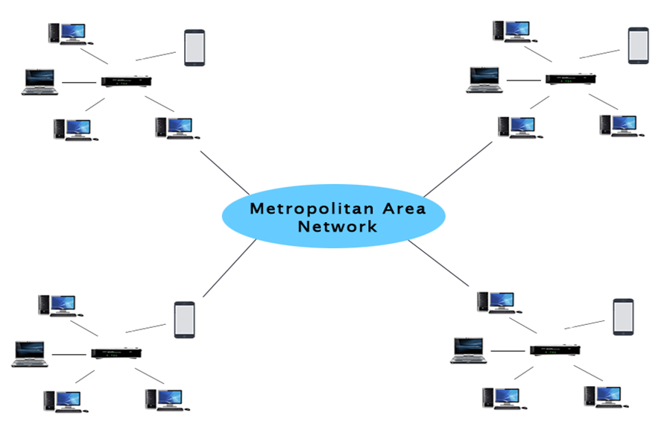
Types of Networks
Metropolitan Area Network (MAN): A MAN is a network that spans across a city or metropolitan area. It connects multiple LANs within the same region and typically utilizes high-speed connections like fiber optic cables.

Slide 29
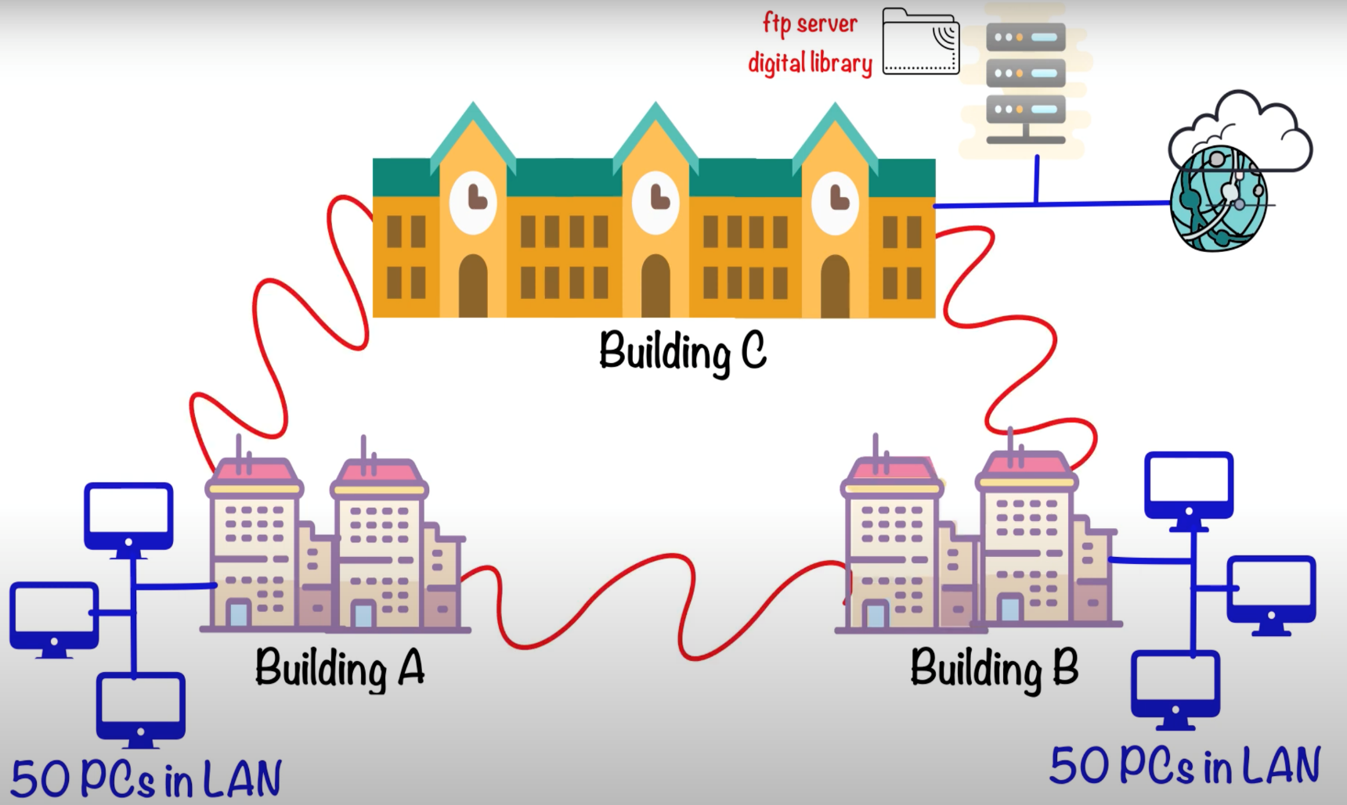

Types of Networks
Campus Area Network (CAN): A CAN is a network that covers a university campus, corporate campus, or any large area like a military base. It connects multiple buildings or locations within a defined area.

Slide 30
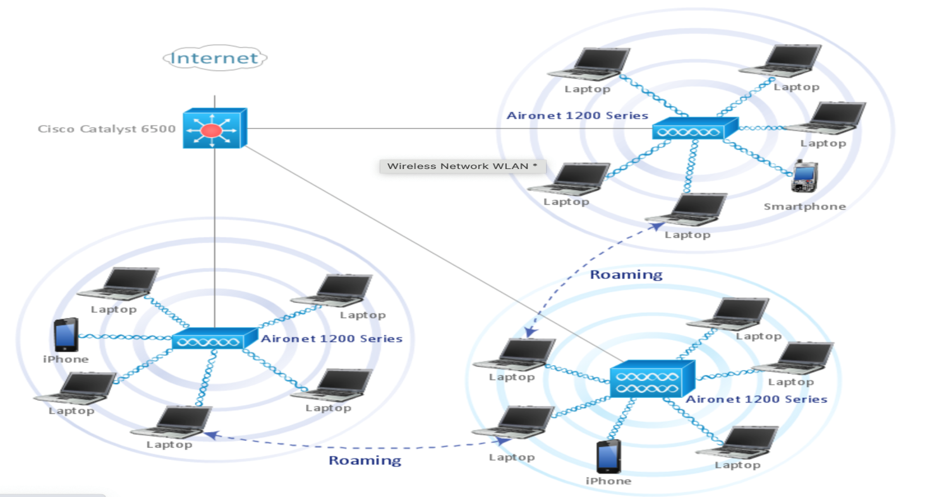
Types of Networks
Wireless Local Area Network (WLAN): A WLAN is a wireless network that allows devices to connect and communicate without physical cables. Wi-Fi technology is commonly used for WLANs, enabling wireless connectivity within a specific area.

Slide 31
Types of Networks
Virtual Private Network (VPN): A VPN is a secure network that is established over a public network, such as the internet. It allows remote users to securely access a private network by encrypting the communication between the user's device and the network.
Peer-to-Peer Network (P2P): In a P2P network, devices connect directly to each other without a centralized server. Each device can act as both a client and a server, enabling sharing of resources and files directly between devices.

Slide 32
Network components
Clients [ Endpoints or End users or nodes].
Servers [ Offer service to clients ].
Network devices [ Devices provide easy way to connect multiple clients to same server ].
Network Media or Medium [ Cables, or WiFi Signal connect clients and servers to others or to network devices ]
Medias are plugged in NIC (Network interface cards) on clients and servers.
Network protocols.

Slide 33
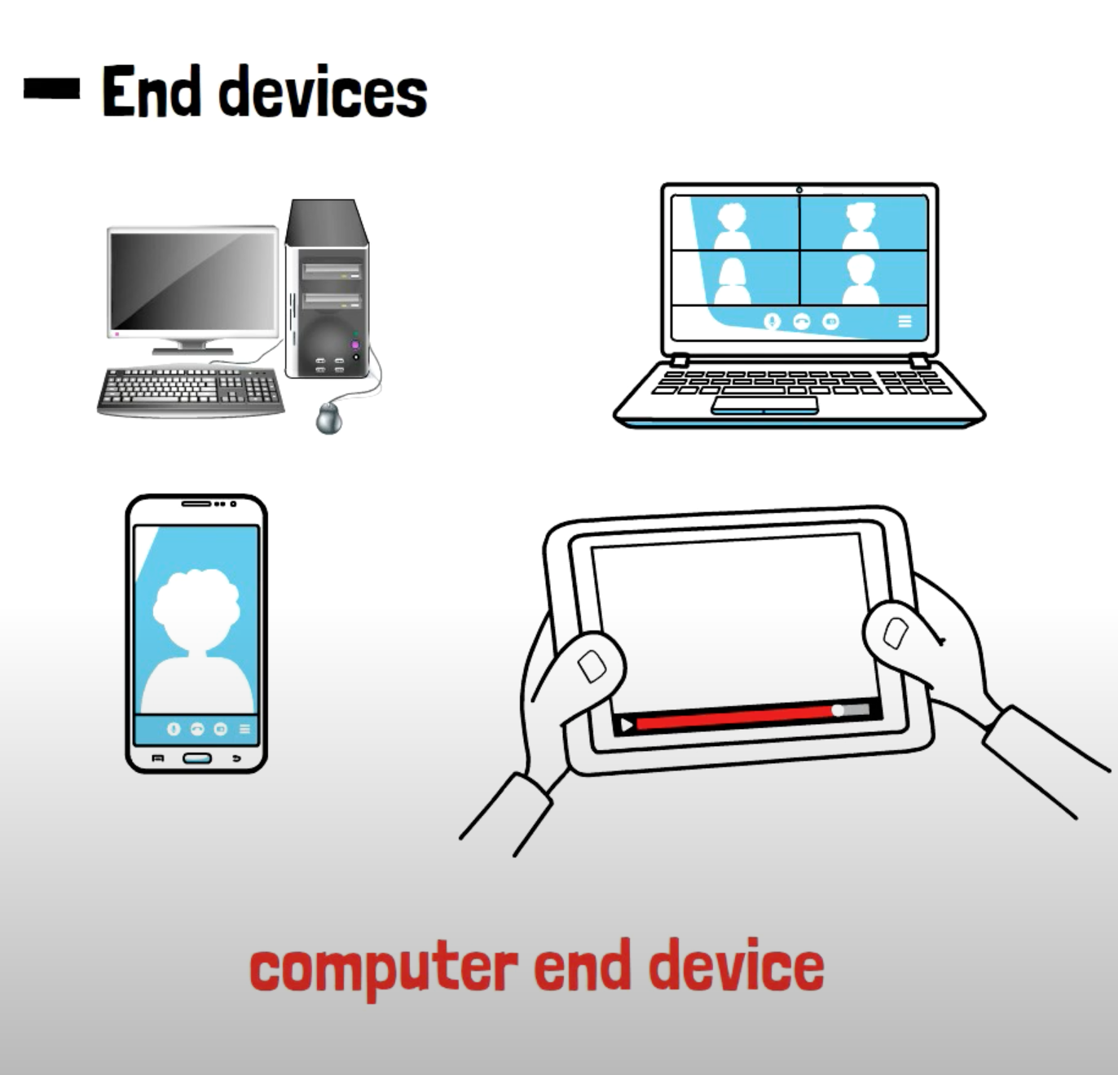
Network components
A client is any device that is sending a request to a server. The internet works on this mechanism. You use a web browser as a ‘client’ to request a web page from a ‘server’.

Slide 34
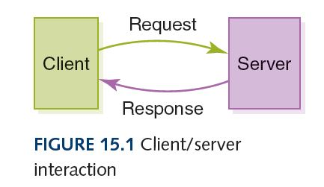
Network components
A server is a computer program or a device that provides functionality for other programs or devices, called "clients".

Slide 35
Network Devices
Network devices refer to the hardware or software components that enable communication and facilitate the operation of computer networks.
These devices play various roles:
Managing network connectivity
Routing data
Ensuring security,
Providing network services.

Slide 36
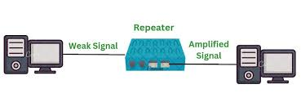
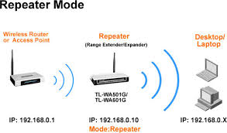
Network Devices
Repeater is a network device used to extend the range of a network by amplifying or repeating the signals it receives.
Repeaters are commonly used in wireless and wired networks to overcome limitations related to signal attenuation and distance.

Slide 37

Network Devices

Slide 38
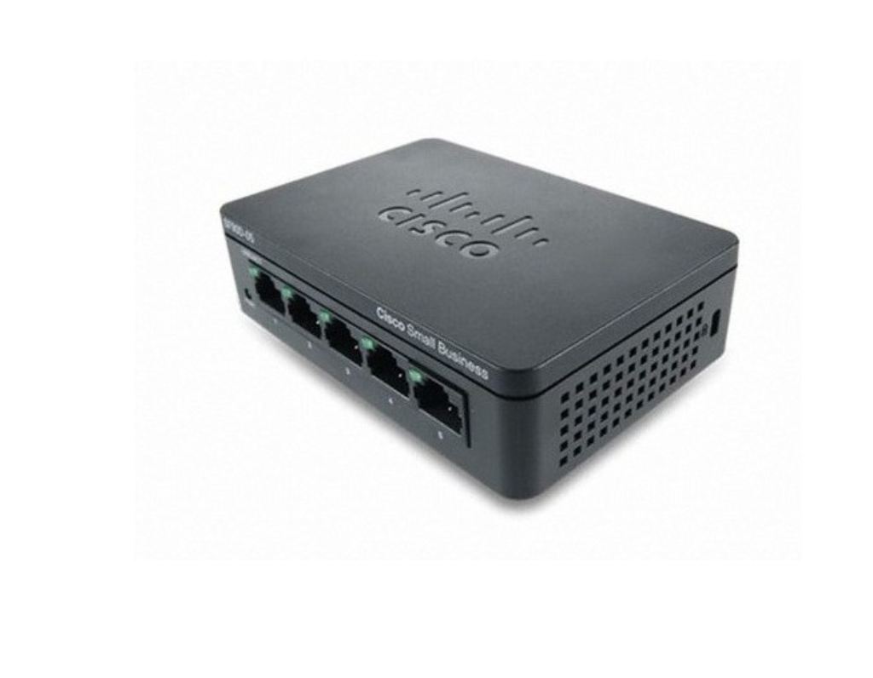
Network Devices
Hub: hub is a basic networking device that operates at the physical layer of the network. It serves as a central connection point for multiple devices in a local area network (LAN).

Slide 39
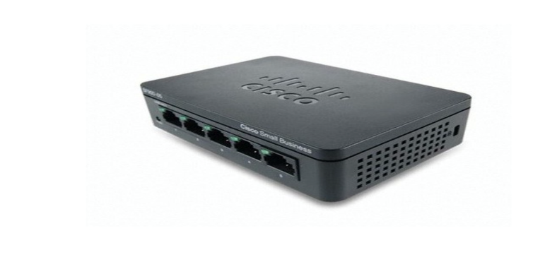
Network Devices
Hubs are basic networking devices that broadcast data to all connected devices.
Hubs create a single collision domain, leading to potential data collisions and network congestion.
Hubs can lead to reduced network performance as more devices are added or traffic increases.

Slide 40
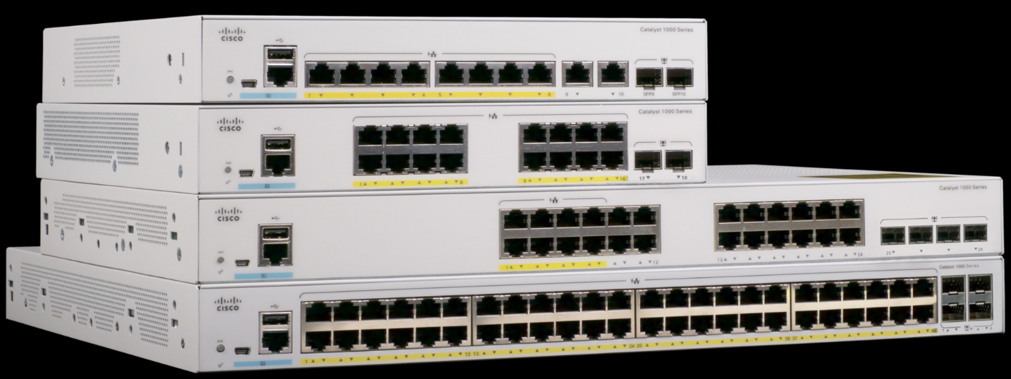
Network Devices
Switches: Switches are devices that connect multiple devices within a local area network (LAN).
They receive data packets and forward them to the appropriate destination based on the MAC (Media Access Control) addresses of the devices.

Slide 41
Network Devices
Switches maintain MAC address tables for efficient data forwarding.
They forward unicast traffic directly to the intended destination.
Switches segment networks into separate collision domains.
VLAN support allows logical network segmentation for security and traffic optimization.
Spanning Tree Protocol (STP) prevents network loops.
Layer 3 switches provide basic routing functionality at the network layer

Slide 42
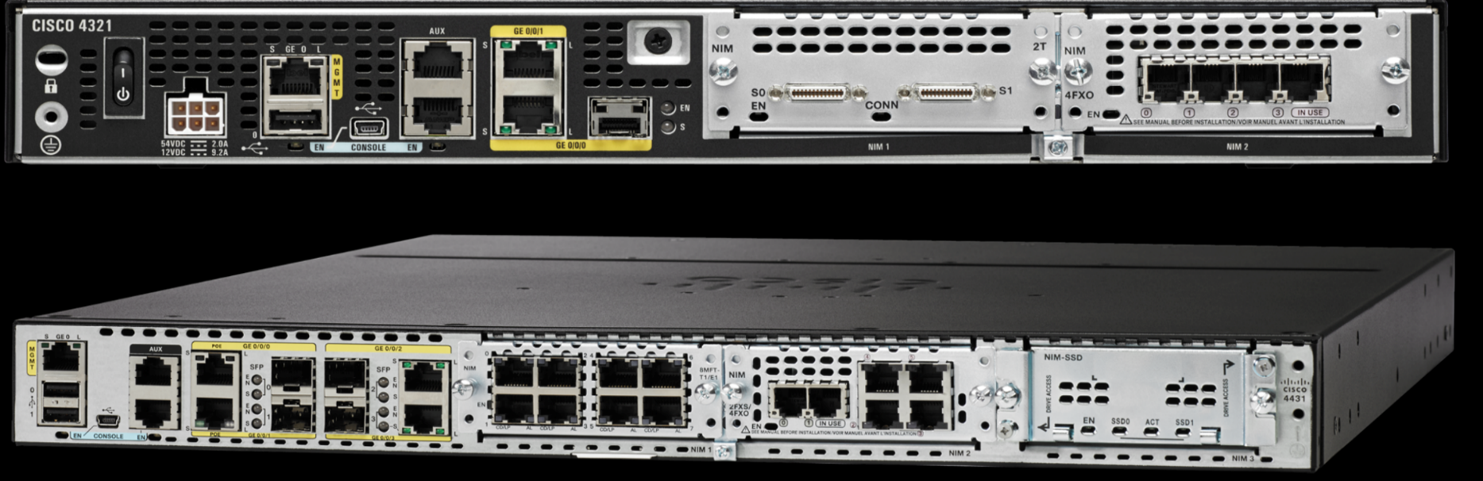
Network Devices
Routers: Routers are responsible for connecting different networks together, such as connecting a local network to the internet.
They use routing protocols to determine the best path for data to reach its destination across multiple networks.

Slide 43
Network Devices
Routers connect and route data between different networks.
They use IP addresses and routing tables to determine data packet paths.
Routers often serve as gateways to the internet for home and office networks.
Network Address Translation (NAT) is used to share a single public IP address among multiple devices.
Routers provide security features such as firewalls to filter and protect network traffic.

Slide 44
Network Devices
6.Some routers support VLANs for network segmentation.
7.Quality of Service (QoS) can be implemented to prioritize specific types of traffic.
8.Dynamic routing protocols allow routers to adapt to changing network conditions.
9.Wireless routers combine routing and wireless access point functions.
10.Routers may support VPNs for secure data transmission between remote locations or users.

Slide 45

Network Devices

Slide 46
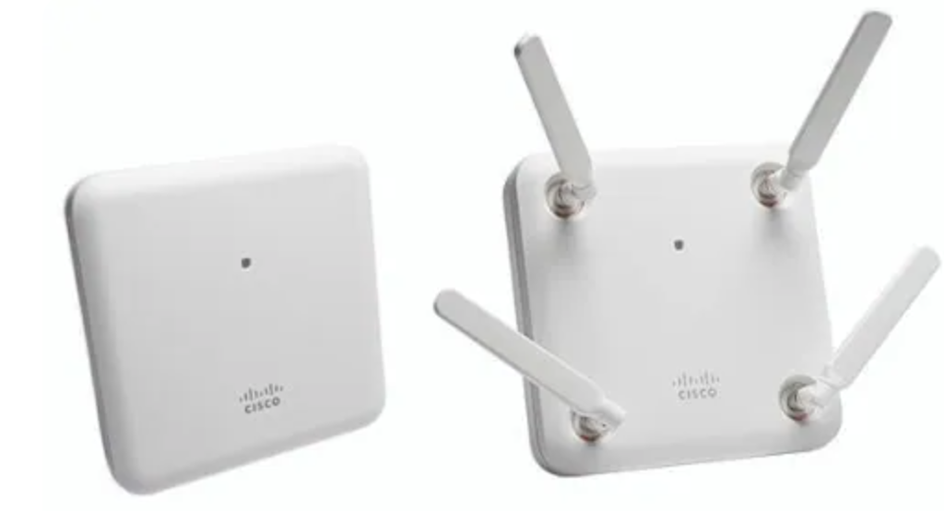
Network Devices
Wireless Access Points (WAPs): WAPs enable wireless connectivity by creating wireless local area networks (WLANs). They allow wireless devices to connect to a wired network or the internet.

Slide 47
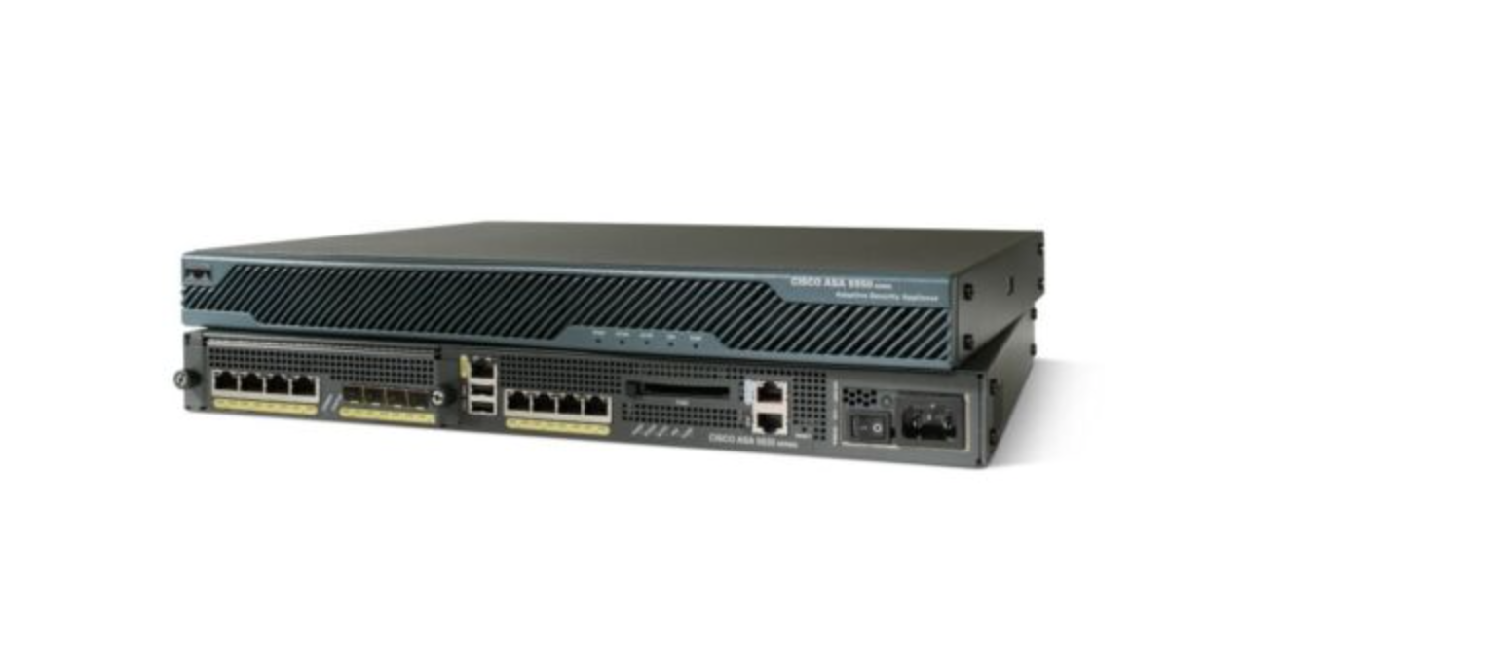
Network Devices
Firewalls: Firewalls are security devices that control and monitor network traffic based on predefined security rules. They protect the network by filtering incoming and outgoing traffic and preventing unauthorized access.

Slide 48
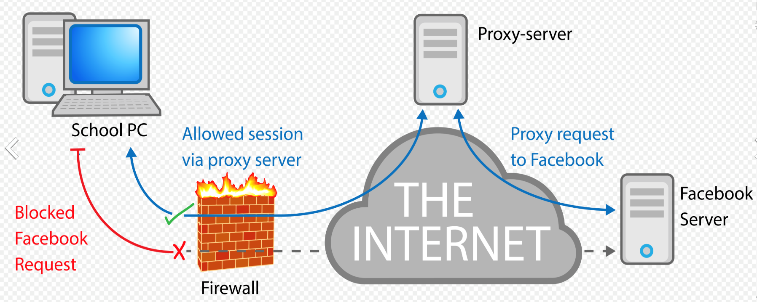
Network Devices
Network Proxies: Proxies act as intermediaries between clients and servers. They receive client requests, forward them to the appropriate servers, and relay the responses back to the clients. Proxies can provide caching, content filtering, and enhance security by hiding the clients' IP addresses.

Slide 49
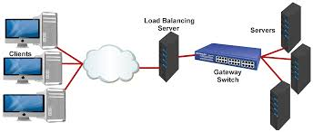
Network Devices
Network Load Balancers: Load balancers distribute network traffic across multiple servers or network links to optimize resource utilization, improve performance, and ensure high availability of network services.

Slide 50
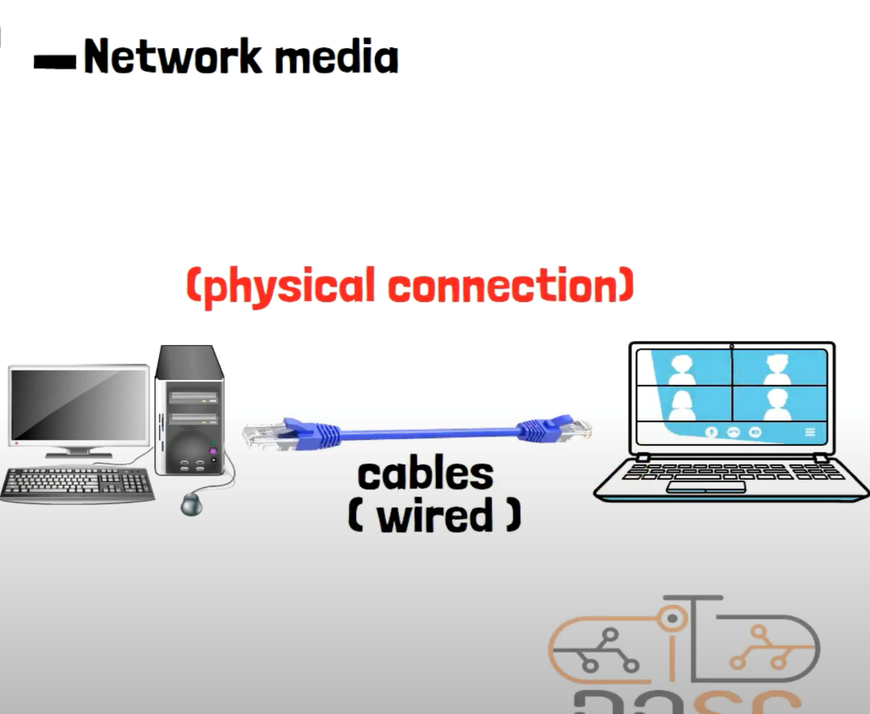
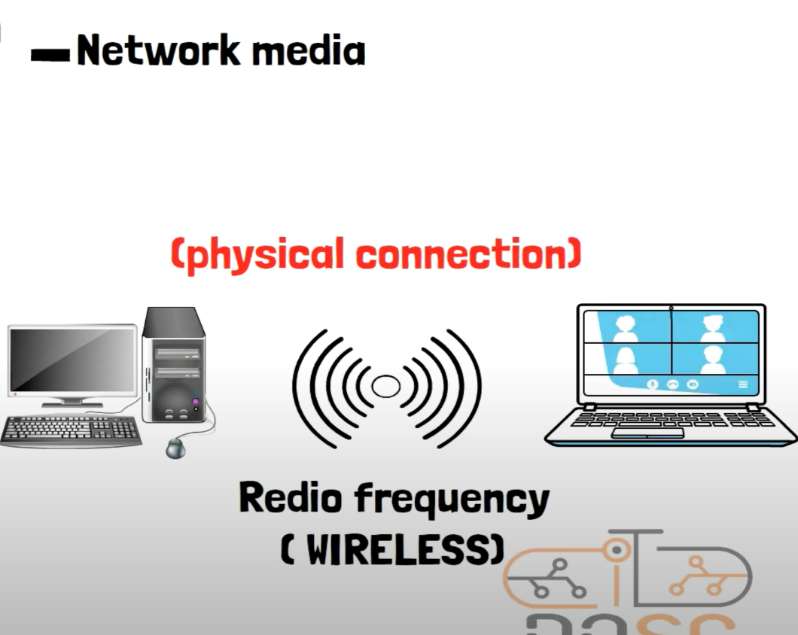
Network Media
Network media: also referred to as network communication media or network transmission media, are the physical channels through which data is transmitted in a computer network.

Slide 51
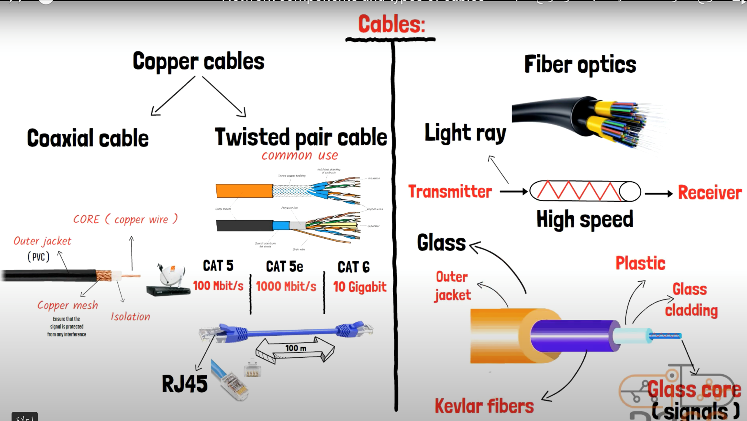
Network Media

Slide 52
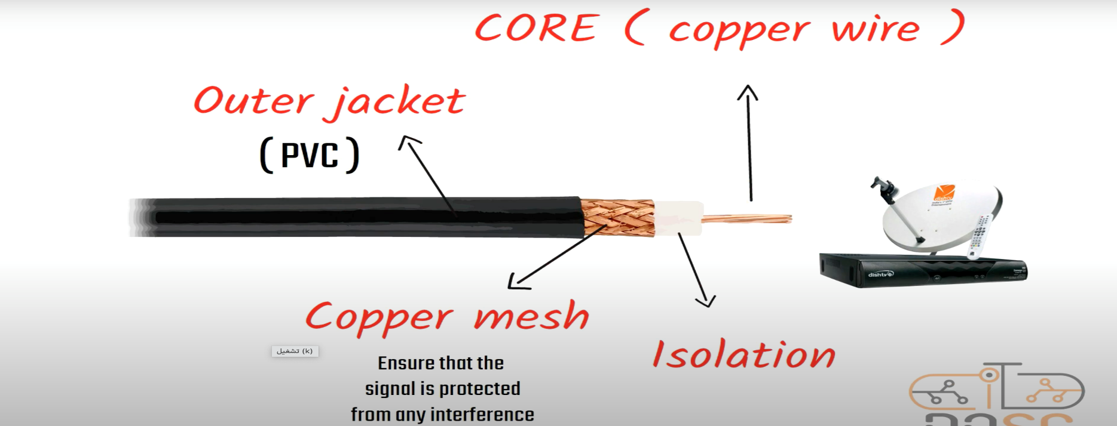
Network Media
Coaxial Cable: Coaxial cables consist of a central conductor surrounded by insulation, a metallic shield, and an outer jacket. They were commonly used in older Ethernet networks and cable television (CATV) systems. However, their usage has decreased with the rise of twisted pair and fiber optic cables.

Slide 53

Network Media

Slide 54
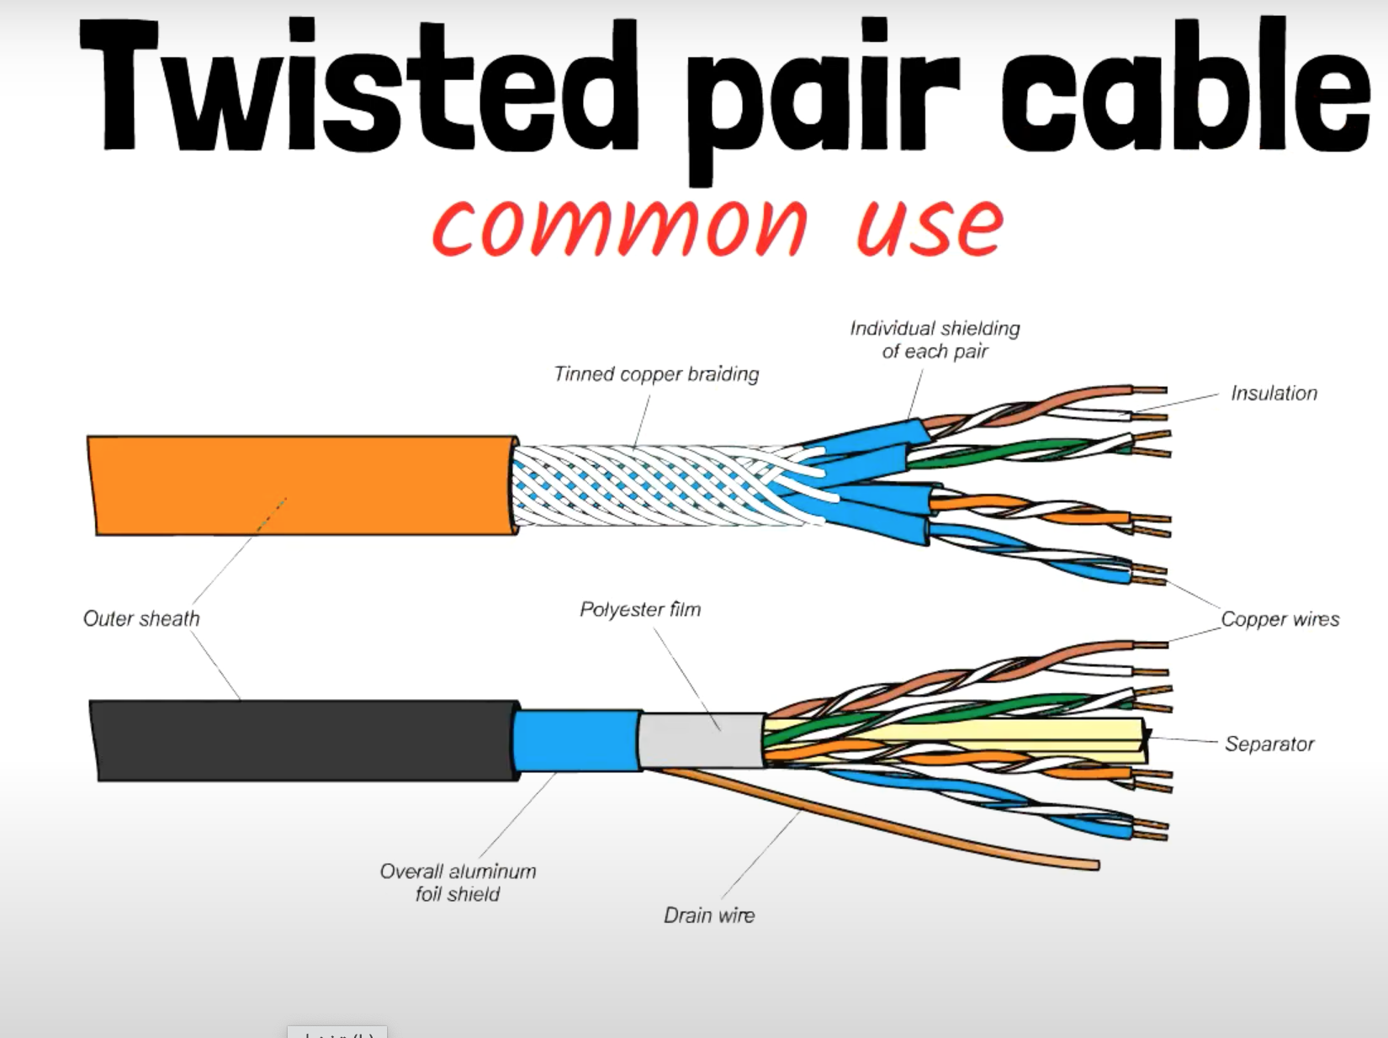
Network Media
Twisted Pair Cable: Twisted pair cables are widely used in Ethernet networks. They consist of pairs of insulated copper wires twisted together to reduce electromagnetic interference. Twisted pair cables are categorized into two main types:
Unshielded Twisted Pair (UTP): UTP cables are commonly used for Ethernet connections in homes and offices. They are inexpensive and flexible, making them easy to install.
Shielded Twisted Pair (STP): STP cables have additional shielding to minimize electromagnetic interference. They are often used in environments with higher interference, such as industrial settings.

Slide 55
Network Media
categories of twisted pair cables:
Cat 5 (Category 5): Cat 5 cables were widely used in the past and supported data transmission speeds up to 100 Mbps (megabits per second). They consist of four twisted pairs of copper wires and are typically terminated with RJ-45 connectors. Cat 5 cables are capable of transmitting data up to 100 meters.
Cat 5e (Category 5e): Cat 5e cables, also known as Category 5 enhanced cables, are an improved version of Cat 5 cables. They offer better performance and reduced interference compared to Cat 5. Cat 5e cables can support data transmission speeds up to 1 Gbps (gigabit per second)

Slide 56
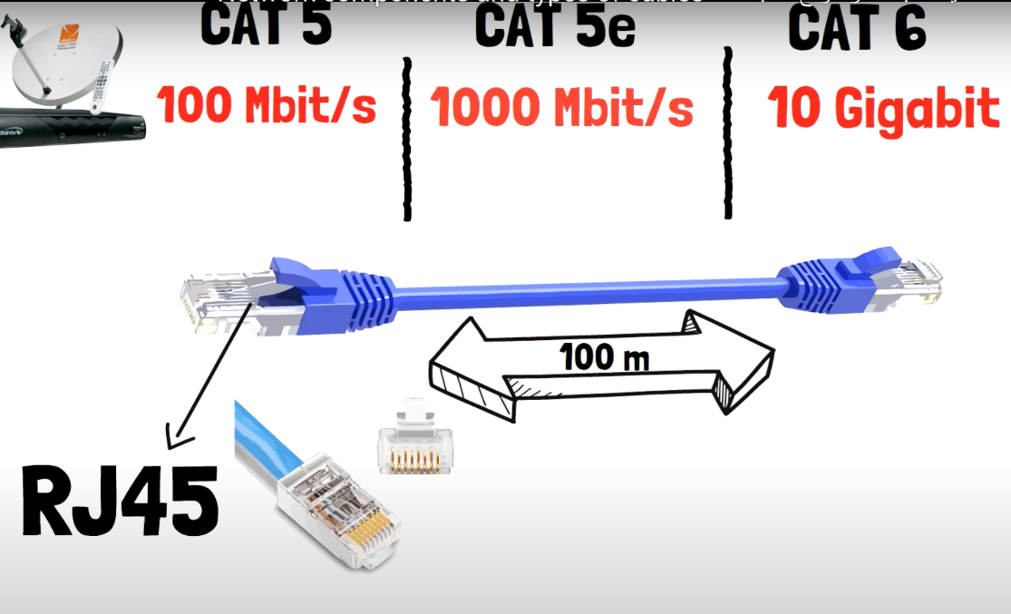
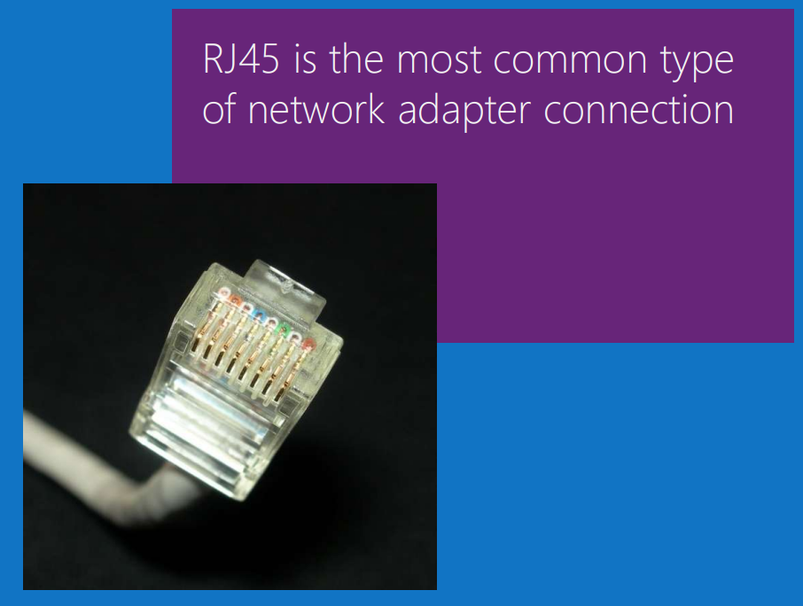
Network Media
categories of twisted pair cables:
Cat 6 (Category 6): Cat 6 cables provide even higher performance and faster data transmission speeds compared to Cat 5 and Cat 5e cables. They are designed to support data rates up to 10 Gbps over shorter distances.
Data transfer rate defines the maximum bits per second (bps) that can be transmitted over a network.

Slide 57
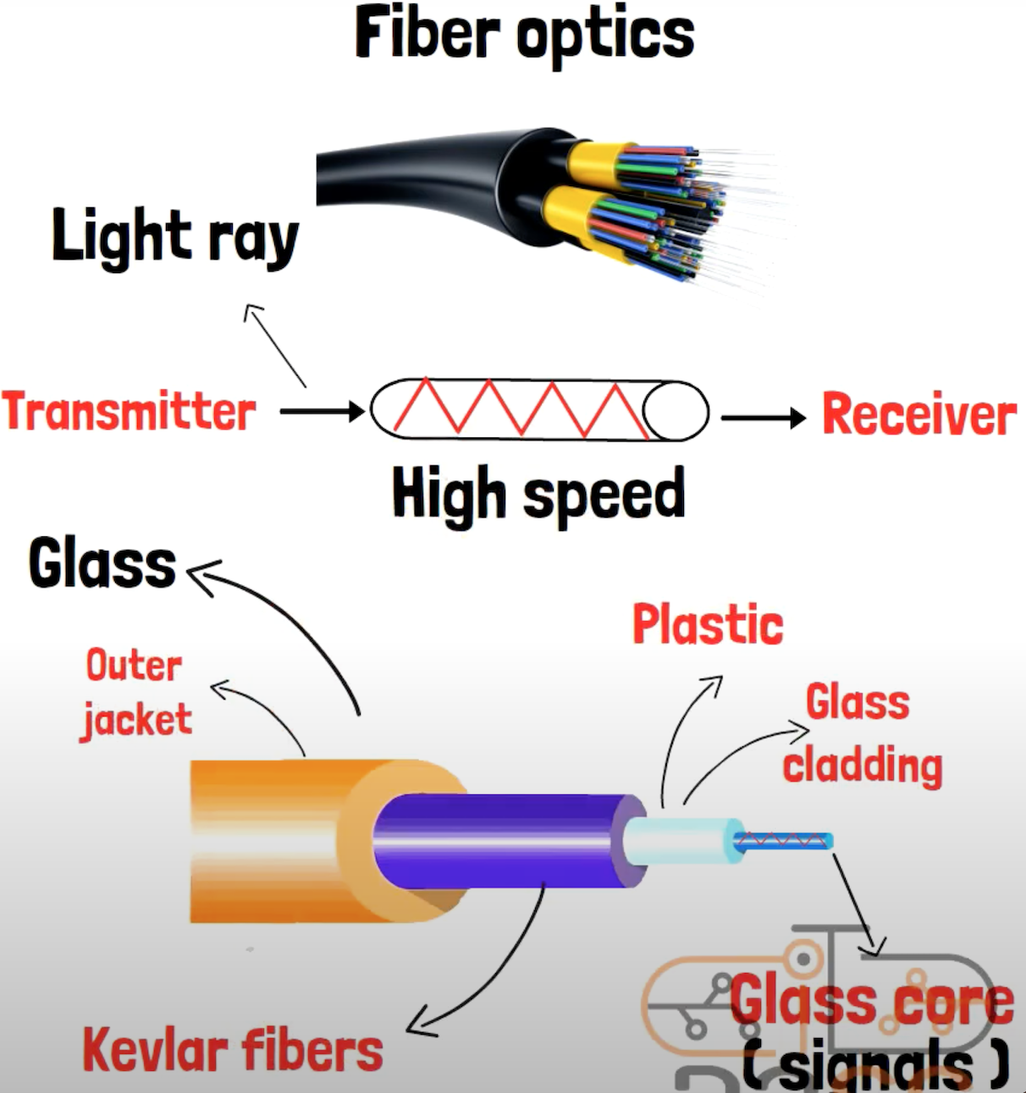
Network Media
Fiber Optic Cable: Fiber optic cables use thin strands of glass or plastic to transmit data as pulses of light. They offer high data transmission speeds, long-distance capabilities, and resistance to electromagnetic interference. Fiber optic cables are commonly used in high-speed networks, long-haul connections, and telecommunications infrastructure.

Slide 58
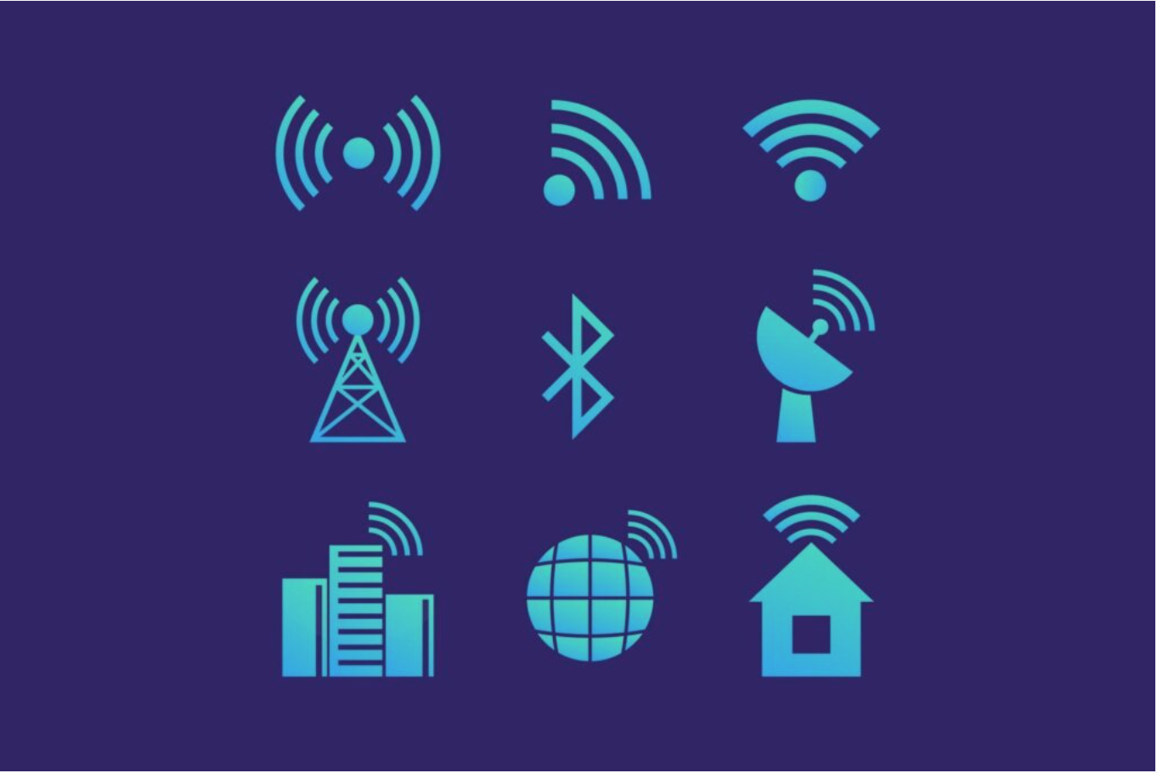
Network Media
Wireless Media: Wireless communication allows data transmission without the need for physical cables. It uses radio waves, microwaves, or infrared signals to transmit data between devices. Wireless media includes technologies such as Wi-Fi (Wireless Fidelity), Bluetooth, cellular networks, satellite communication, and infrared communication.

Slide 59
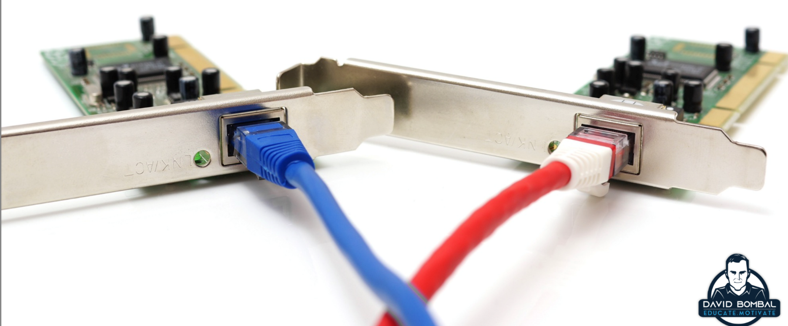
Network interface cards
A network interface card (NIC), also known as a network adapter or network card, is a hardware component that enables a computer or device to connect to a computer network. It provides the physical interface between the computer and the network, allowing the transmission and reception of data.

Slide 60
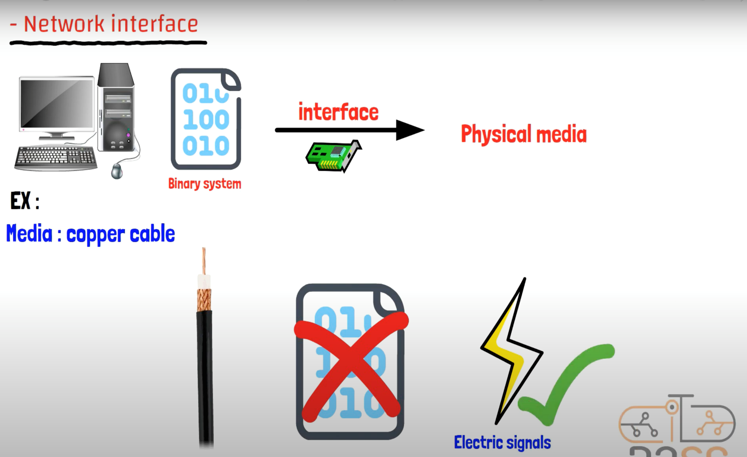
Network interface cards

Slide 61
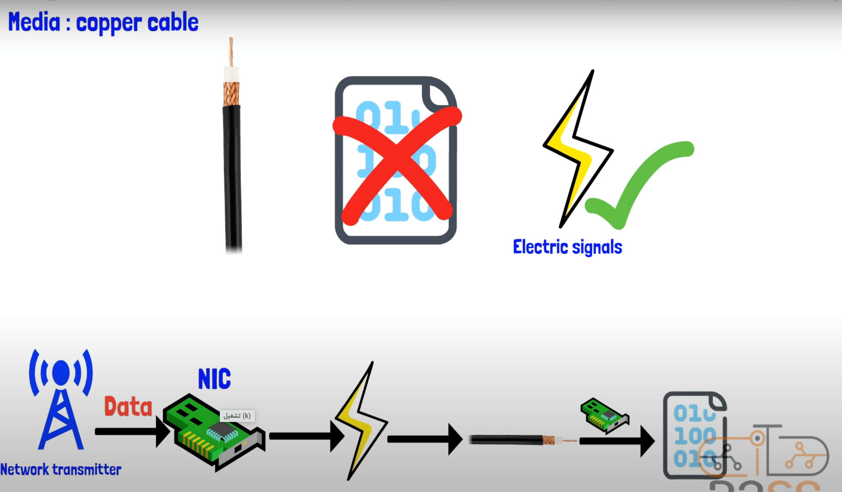
Network interface cards

Slide 62
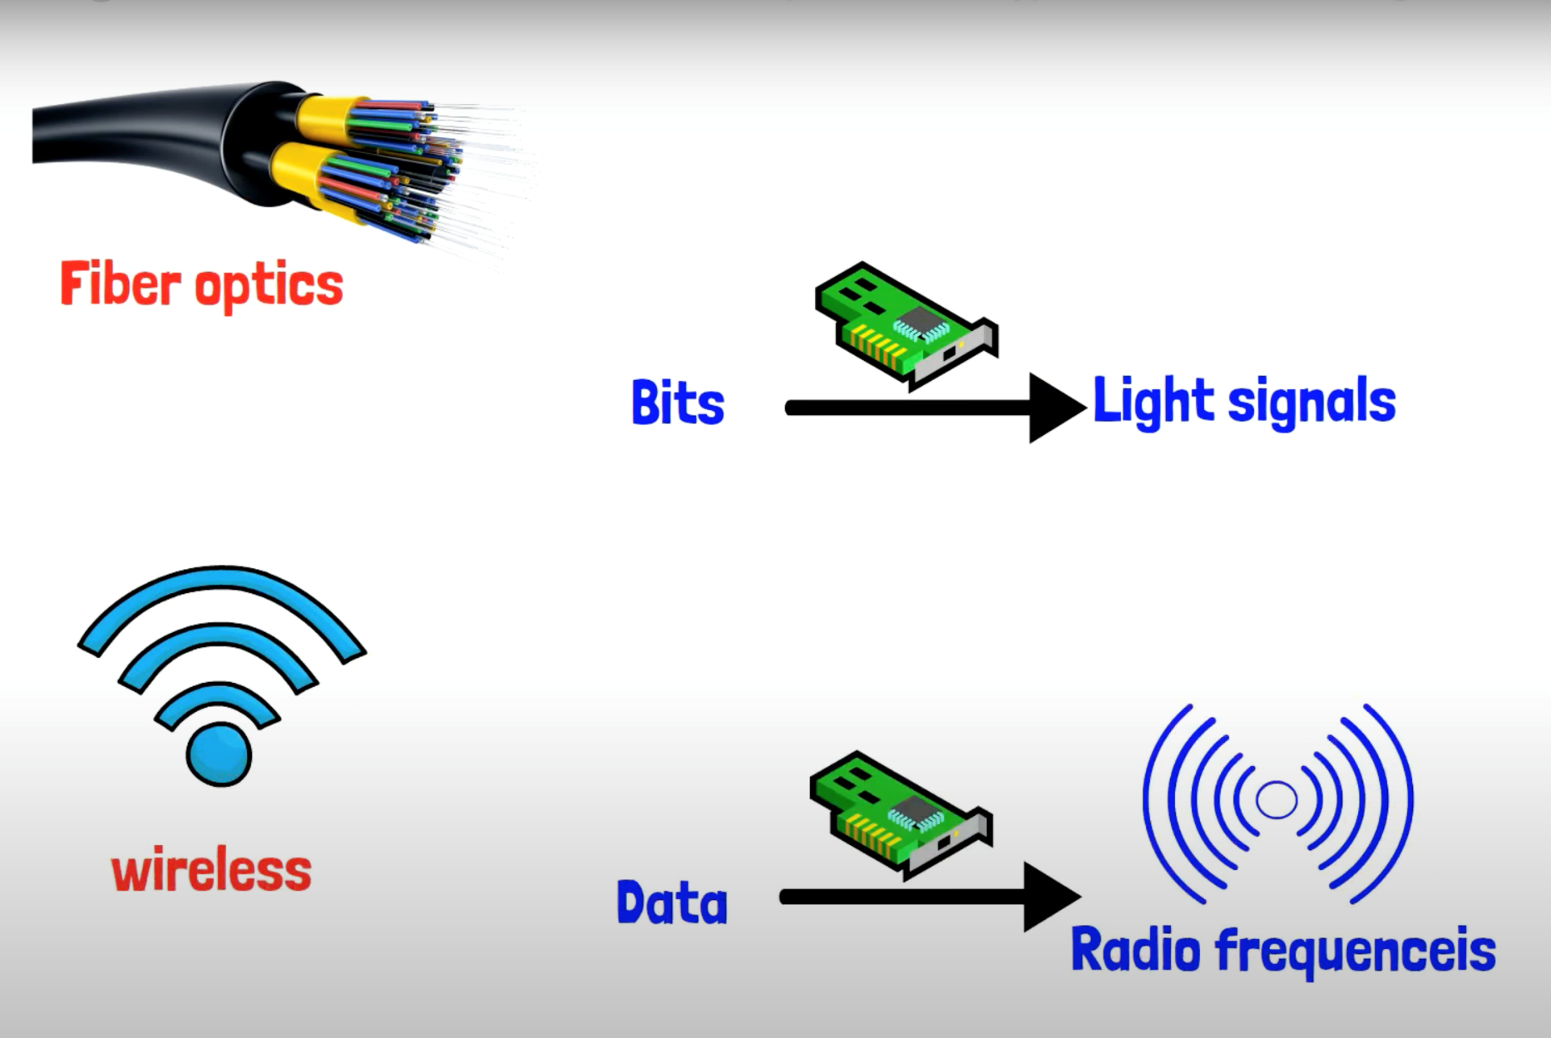
Network interface cards

Slide 63
MAC address
A MAC address, short for Media Access Control address, is a unique identifier assigned to network interface controllers (NICs) by the manufacturer.
It is a hardware address that uniquely identifies a device on a network.
Every device that has network capabilities, such as a network interface card or a Wi-Fi adapter, is assigned a unique MAC address.

Slide 64
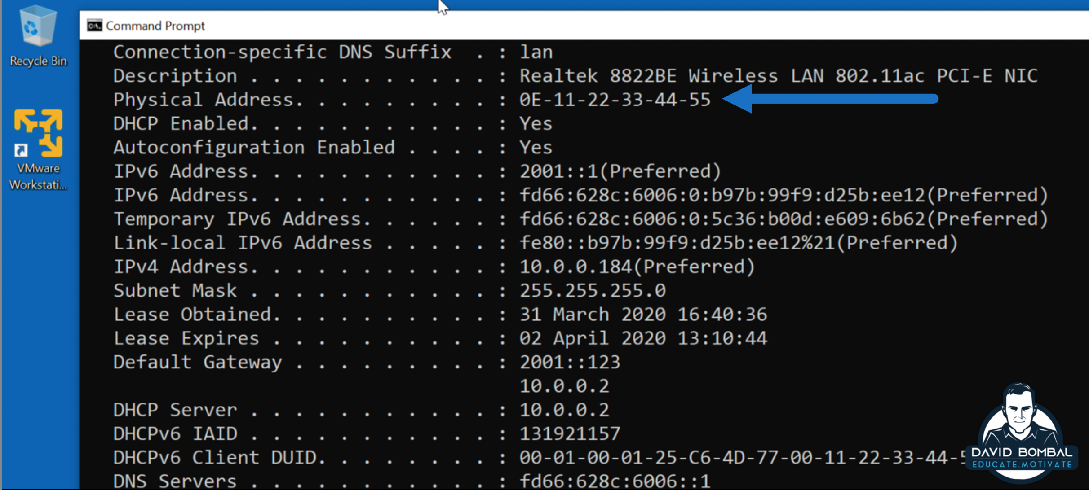
MAC address

Slide 65
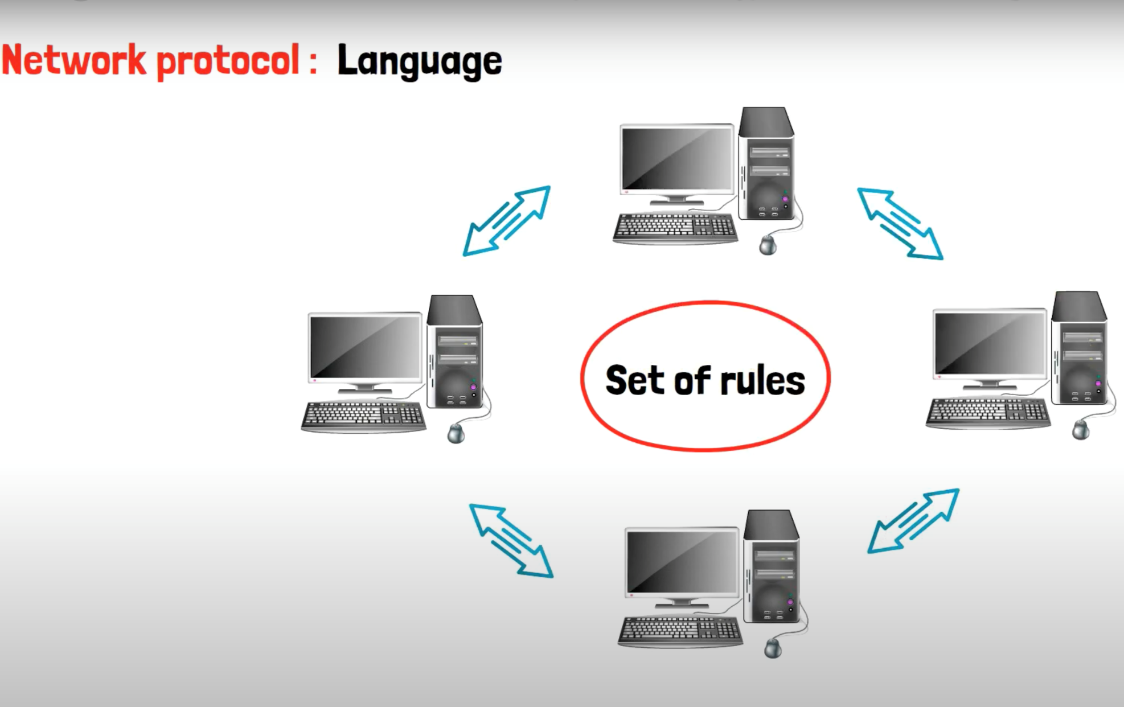
Network protocols

Slide 66
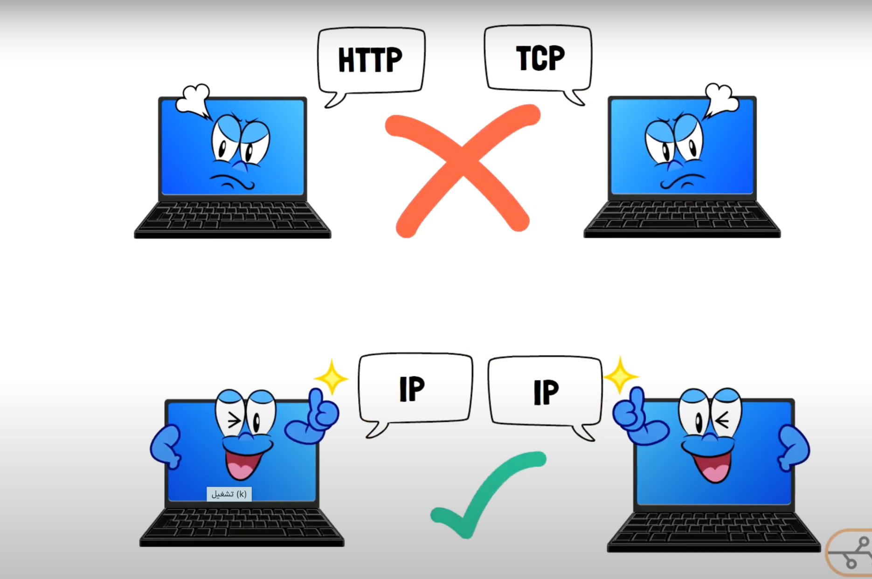
Network protocols

Slide 67
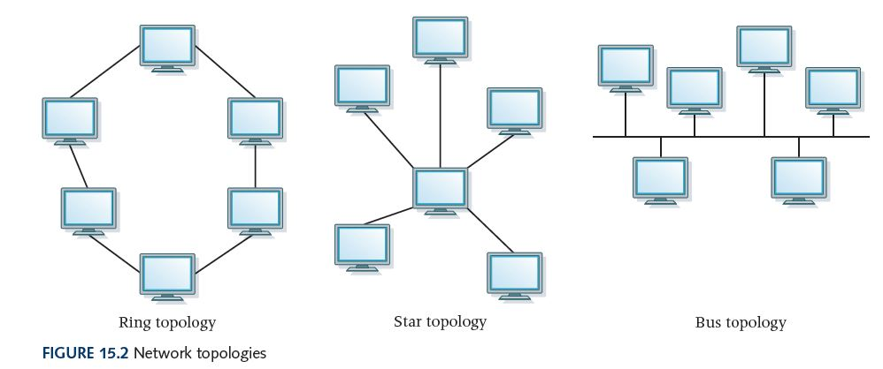
Network Topology
Network topology refers to the physical or logical arrangement of devices and connections in a computer network. It describes how devices are connected and the structure of the network.

Slide 68
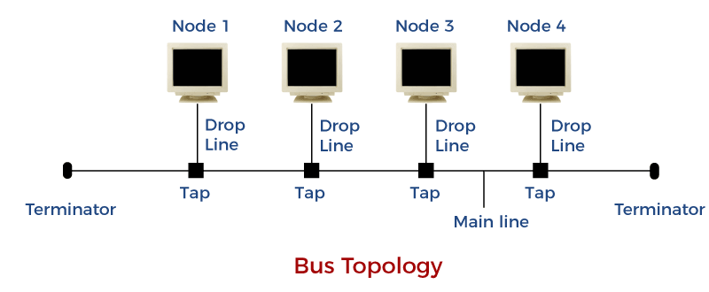
Bus Topology
Bus Topology: In a bus topology, devices are connected to a single shared communication line, known as a bus. All devices receive the same signals, and data is transmitted in both directions. However, if there is a break in the bus, the entire network can be affected.

Slide 69
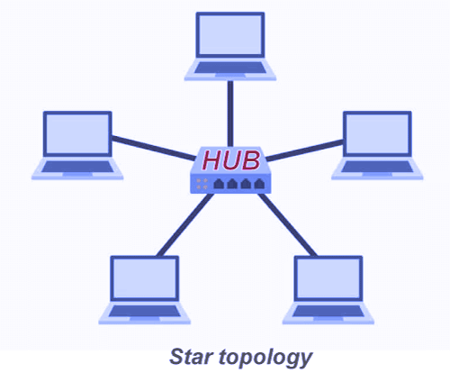
Star Topology
Star Topology: In a star topology, devices are connected to a central hub or switch. All communication between devices is routed through the hub. If one device fails, it does not affect the other devices, but if the central hub fails, the entire network can be disrupted.

Slide 70
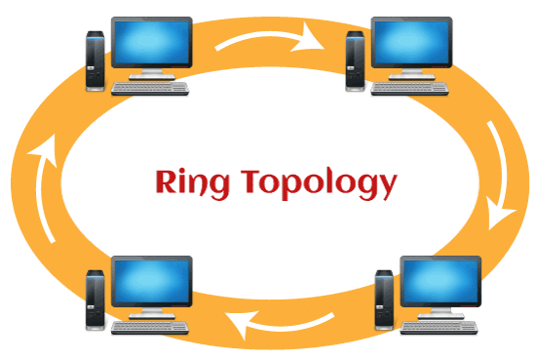
Ring Topology
Ring Topology: In a ring topology, devices are connected in a closed loop. Each device is connected to the next device, forming a ring. Data is transmitted in one direction around the ring. If one device or connection fails, it can disrupt the entire network.

Slide 71
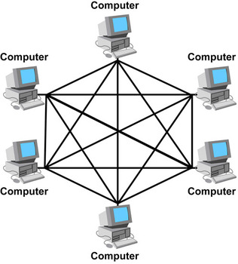
Mesh Topology
Mesh Topology: In a mesh topology, each device is connected to every other device in the network. This provides redundancy and multiple paths for data to travel, ensuring high reliability. Mesh topologies can be full mesh (every device is connected to every other device) or partial mesh (only some devices are connected to others).

